Slide 1
Title: Obstacle Detection System
A Smart Approach for Safer Navigation Obstacle Detection System
Presented by:
Group 53
Raj Priya Singh, CST-2B, 32, 12023002022113 Prince Kumar, CST-2B, 52, 12023002022133 Aditya Kumar, CSIT-2A, 57, 12023002023052 Aditya Kumar, CSIT-2A, 56, 12023002023051 Kalpana Kumari, CST-2A, 50, 12023002022214

Slide 2
Overview of Obstacle Detection System
An obstacle detection system uses sensors and algorithms to identify obstacles in the path of a moving object, ensuring safety and efficiency in navigation.

Slide 3
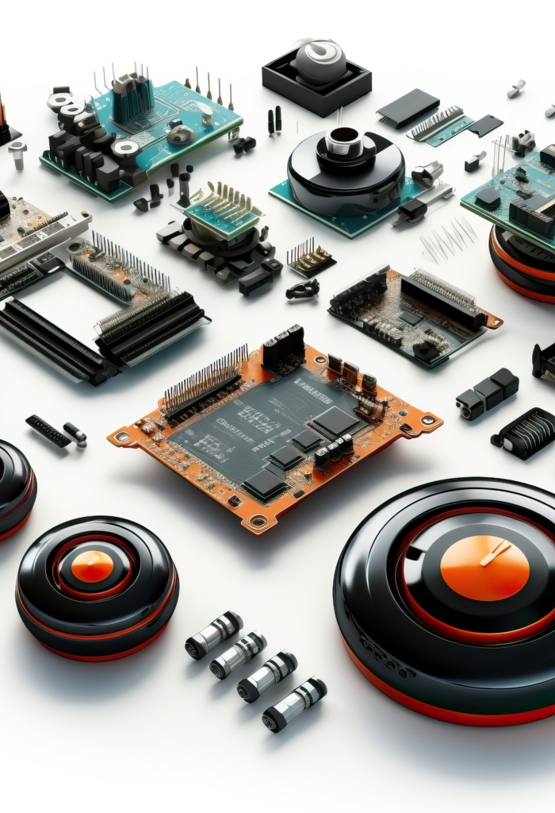
Components Used in the System
Ultrasonic Distance Sensor (4-pin) Microcontrollers
Communication Module
Power supply
Ultrasonic Distance Sensor measures distance using sound waves and echo time.
Processing units such as Arduino are used to control and process data from the sensors.
Wireless technologies facilitate data transfer between components of the system.
The system can be powered by batteries or external power sources to ensure functionality.
01
02
03
04

Slide 4
Components Used in the System
This LCD shows 2 lines of 16 characters. It uses liquid crystals to control light from an LED backlight through polarized layers.
This DC motor creates vibrations by spinning an off-center weight when powered, used for haptic feedback.
This device is a variable resistor controlled by a knob.
Piezo buzzers produce sound by converting electrical current into vibrations and can also convert vibrations back into electrical signals.
05
LCD
Vibration Motor
Potentiometer
Piezo
06
07
08

Slide 5



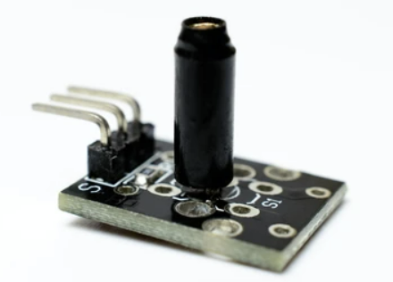

Technology Used
Data Processing
Involves the use of microcontrollers and embedded software for efficient data handling..
Sensing Technologies
Utilizes ultrasonic waves, infrared light, or laser beams to effectively detect obstacles.
Communication
Employs wireless technologies such as Bluetooth and Wi-Fi for remote monitoring capabilities.

Slide 6



Detection principles
Signal Processing Algorithms analyze the signals to detect obstacles and assess the risk of collision.
Detection Mechanism Sensors emit signals and measure reflections to calculate the distance to nearby objects.

Slide 7




working mechanism
Signal Emission Sensors emit waves, utilizing various technologies such as ultrasonic and infrared.
Signal Reflection The emitted waves bounce back when they encounter obstacles.
Distance Calculation The system measures the time taken for the waves to return, thus determining the distance to the obstacle.
Alert Mechanism When an obstacle is detected within a dangerous range, the system triggers alerts or activates safety features.

Slide 8





Improved Safety Prevents collisions and accidents.
High Precision Prevents collisions and accidents.
Cost-Effective Affordable solutions with low maintenance.
Versatile Applications Usable in various industries, from automotive to robotics.

Slide 9

applications
01
Automobiles
Autonomous driving and parking assistance.
Robotics
Safe navigation in dynamic environments.
Drones
Collision avoidance in aerial navigation.
Industrial Automation
Safety in automated processes.
02
03
04

Slide 10

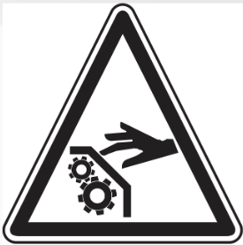

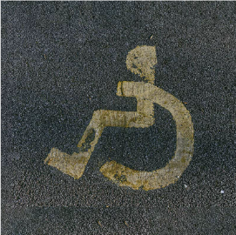

Benefits of Implementing the System
Safety
Minimizes risk of accidents in crowded or hazardous environments.
Efficiency
Improves navigation and operational efficiency.
Accessibility
Assists individuals with limited mobility in navigation.
Environment-Friendly
Reduces energy consumption by optimizing movement.

Slide 11
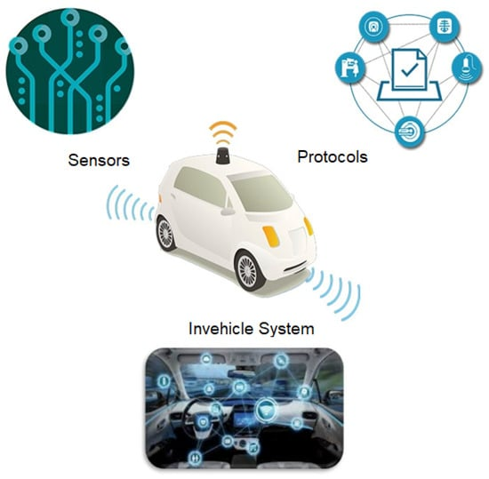
conclusion
Obstacle detection systems are essential for modern navigation and automation, providing safety, efficiency, and versatility across multiple industries.
"With continuous advancements, obstacle detection technology will further revolutionize safety and autonomy in our daily lives."

Slide 12
Thank you

